Slide 1
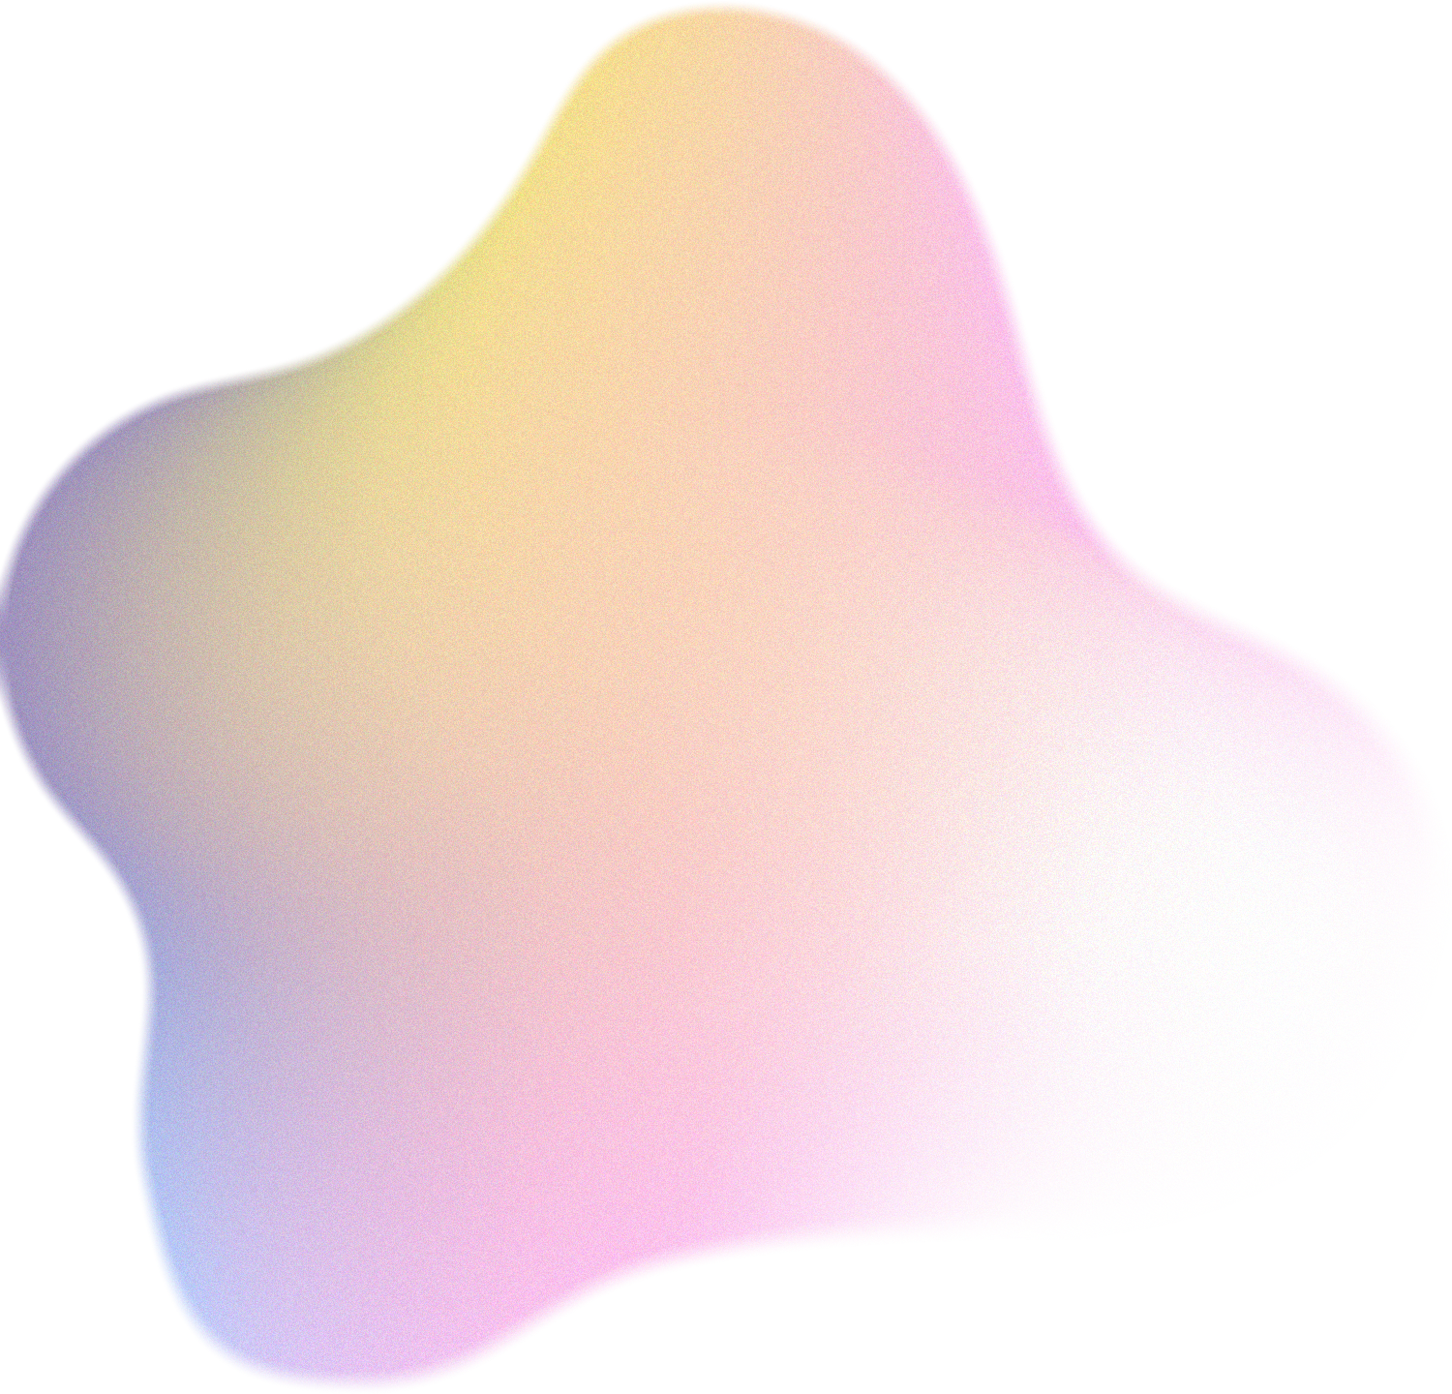
Ocular Disease Recognition
By Sneha Dharne
Internal Guide : Mrs. Veena K. M
Reg No. 190911088

Slide 2
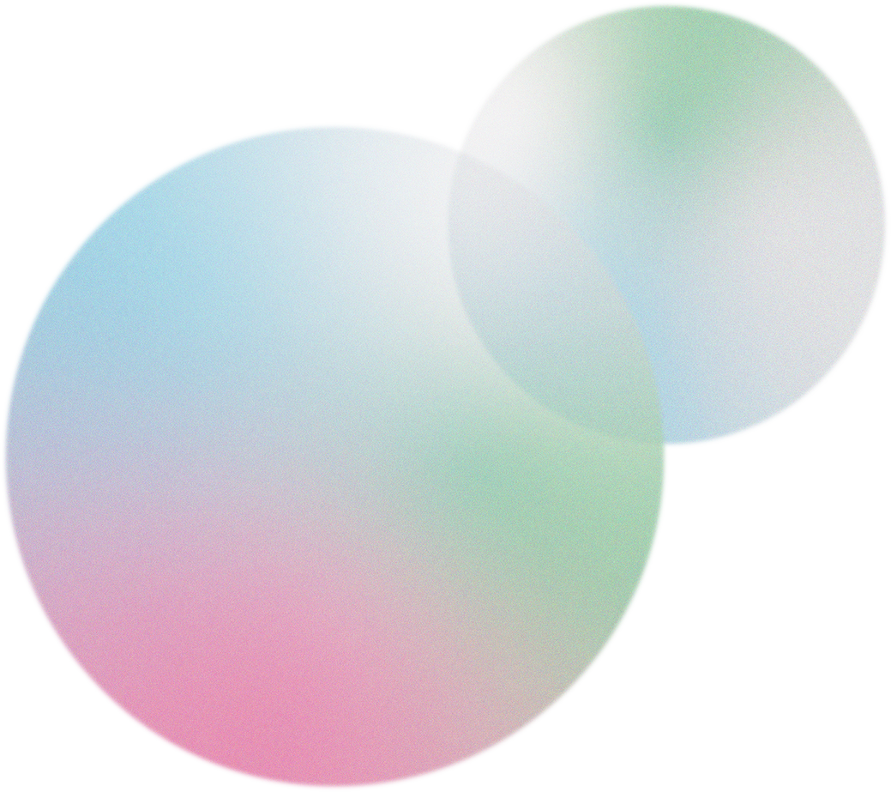
Introduction
Title
Literary Review
Problem Statement
Methodology
Index
Implementation
Pre-processing
Transfer Learning
Evaluation Metrics
Results
Analysis and Conclusion

Slide 3


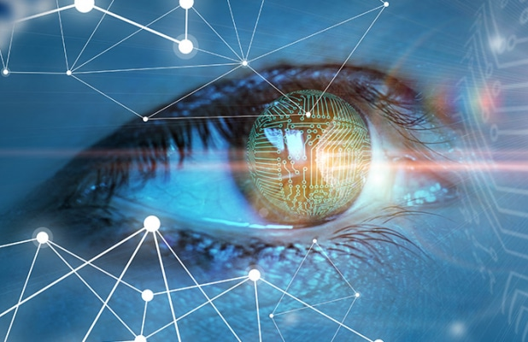
Introduction
Back to Index
Importance of early detection
Interpretation of fundus images
Leveraging transfer learning
Pre-processing techniques

Slide 4
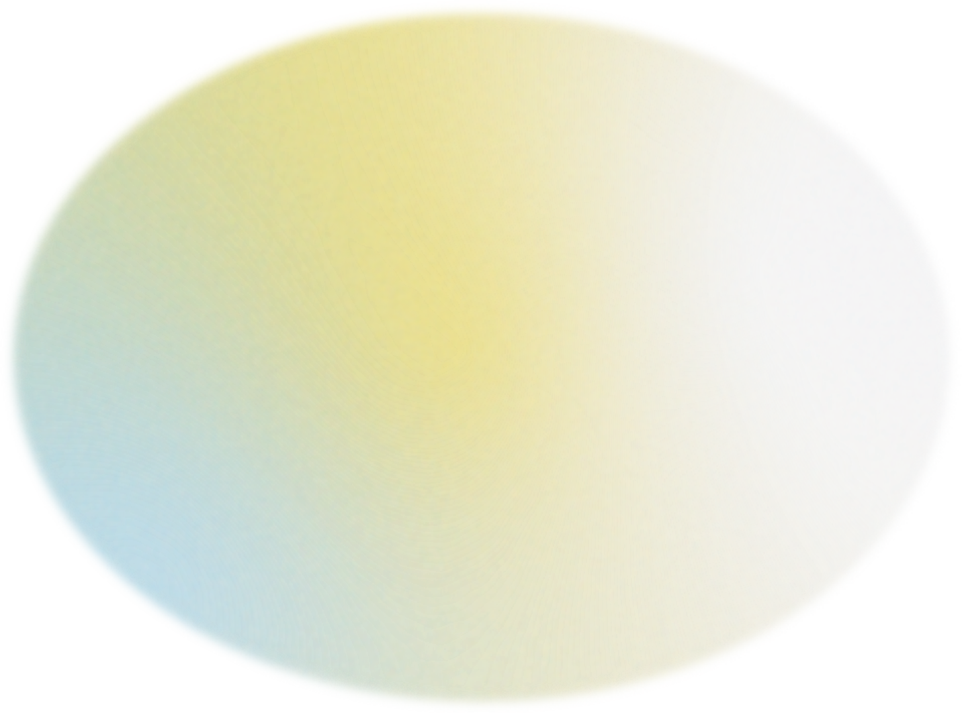
Back to Index
Leveraging transfer learning for Ocular Disease Recognition
A comparative study of various generic preprocessing and transfer learning models to detect chronic ocular diseases at an early stage.

Slide 5

Back to Index
Literary Review
Multi-label binary classification [1]
Generic[1,3] vs Specific Preprocessing[4-8] Techniques
Capture diverse range of ocular diseases on a single patient
Comparison of performance vs computational complexity
Overfitting and degradation problem by increase in depth and training samples in the CNN model
Shallow CNN model by merging both fundus images [2]
Less efficiency and increase in computational complexity

Slide 6
Problem Statement
Back to Index
Literature Insights | Objectives
Overfitting or high computational complexity issues Need to assess performance of generic preprocessing techniques for quick and general classification. | Utilize generic preprocessing techniques for fundus image classification. Use transfer learning leveraging pre-trained models Optimize hyperparameters that maximize performance while minimize computational complexity

Slide 7

Back to Index
Methodology
Implementing transfer learning on pre-processed fundus images.

Slide 8
Implementation
Model Training
RESNET50
VGG16
Back to Index
Hyperparameter Tuning of the pre-trained model
Keras Tuner
Data Collection and Preprocessing
Image Pre-processing
SMOTE and TOMEKLinks

Slide 9
Data Collection
Back to Index
ODIR Challenge Set
https://odir2019.grand-challenge.org/dataset/ 10k Fundus Images (Training and testing) Categories - Normal (N), Diabetes (D), Glaucoma (G), Cataract (C), Age-Related Macular Degeneration (A), Hypertension (H), Myopia (M), Others (O) Each tuple represents filenames of both eyes’ fundus image and the related keyword Converted to a dataset with one fundus images mapped to every related keyword

Slide 10
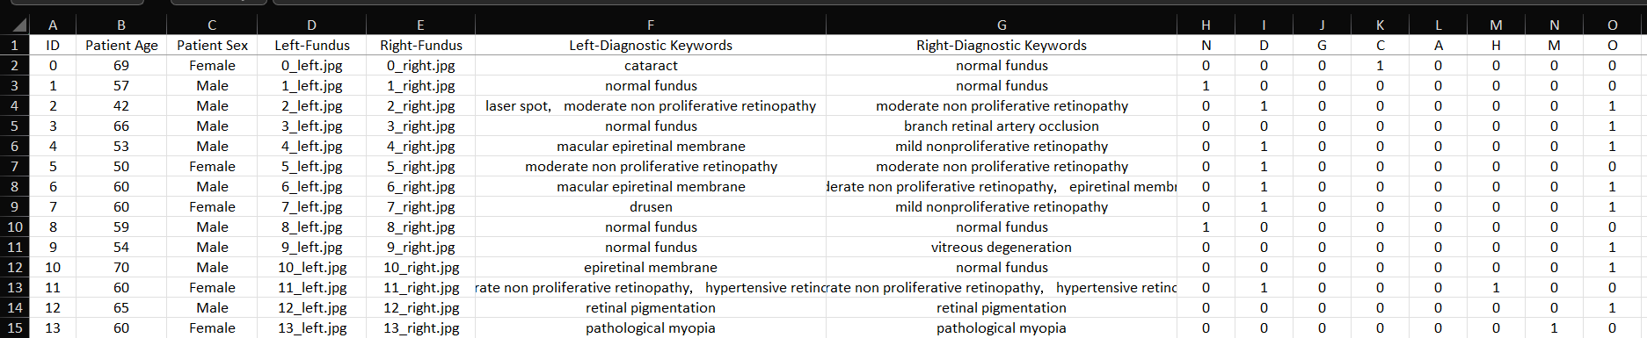
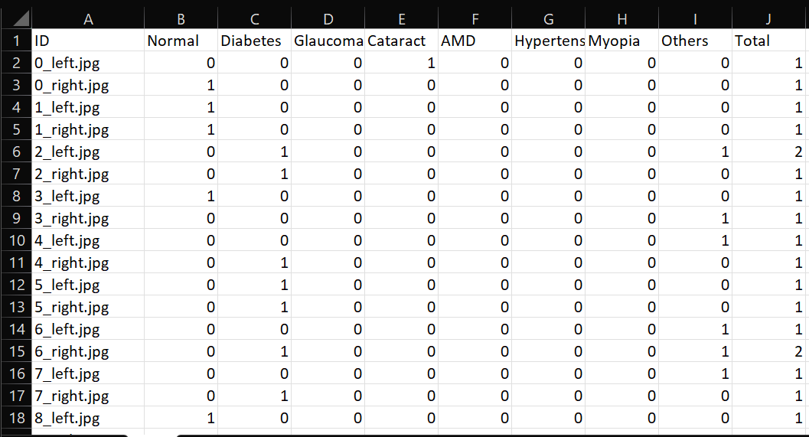
data.xls
Back to Index
odir.csv

Slide 11
Back to Index
Pre-processing
Image Preprocessing.
Class Imbalance.

Slide 12
Back to Index
Preprocessing Techniques
RGB CLAHE
Multi-Scale Retinex with Gaussian Blur
MIRNET model

Slide 13
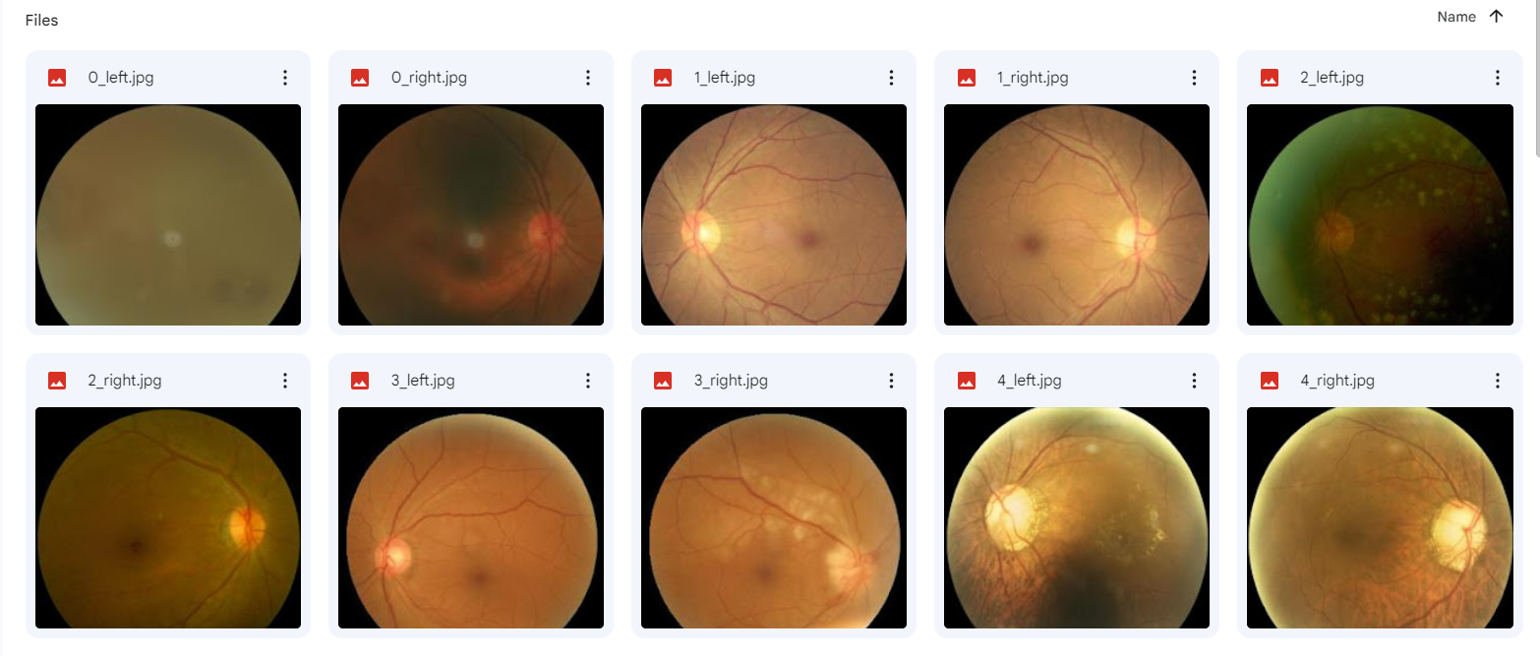
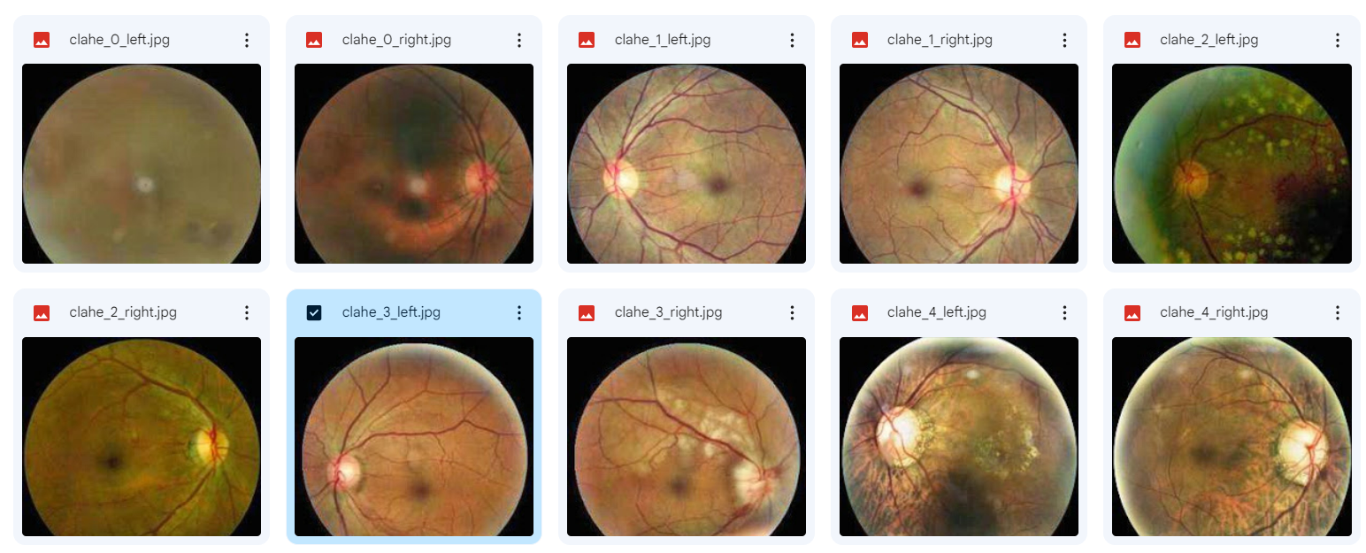
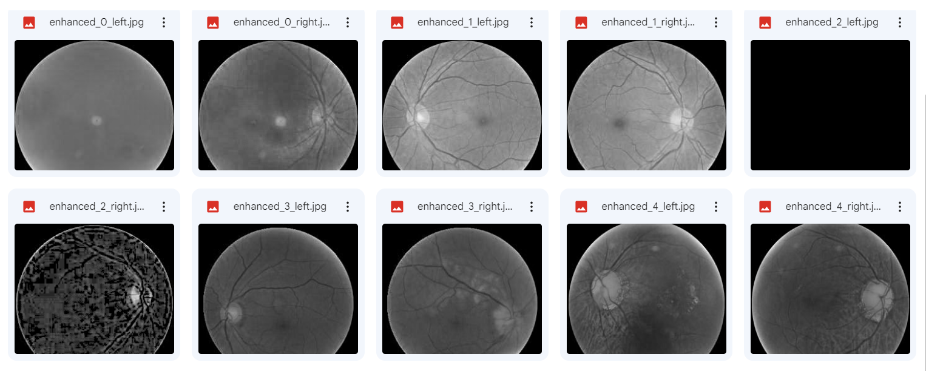
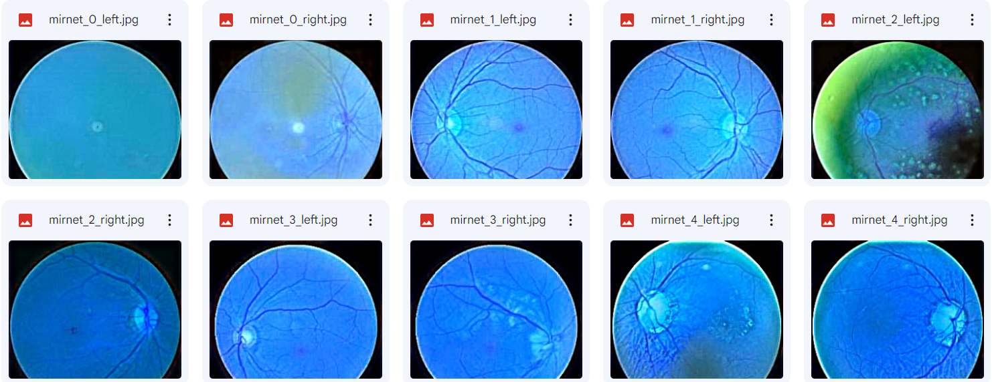
TRAINING IMAGES CROPPED AND RESIZED
RGB CLAHE
MSR WITH GAUSSIAN BLUR
MIRNET
Notes:
Dataset, references,

Slide 14
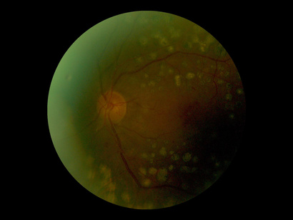
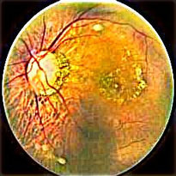
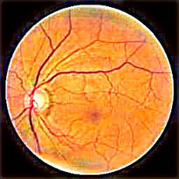
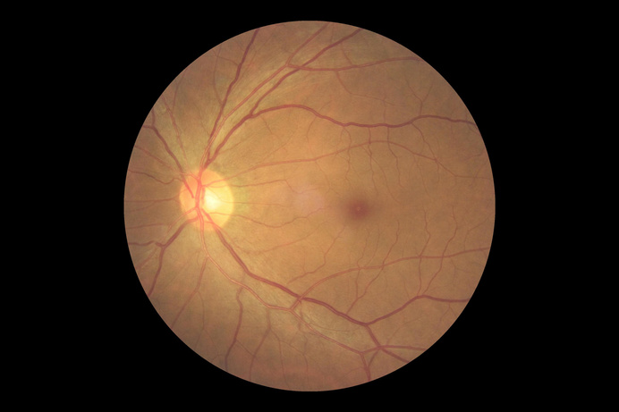
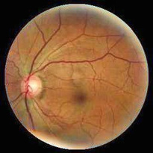
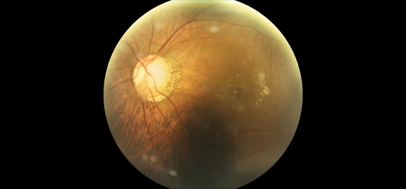
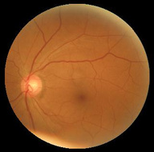
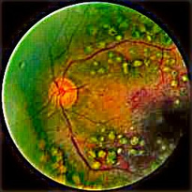
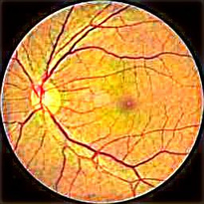
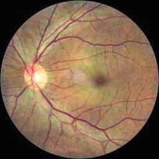
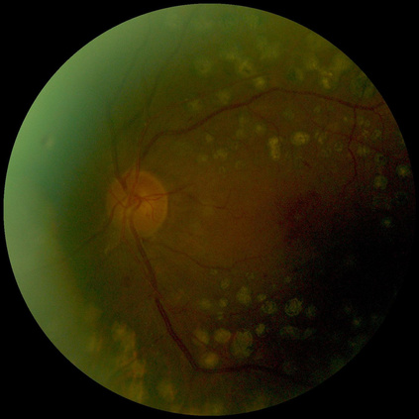
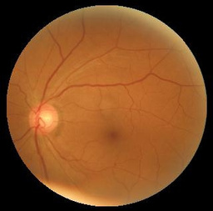
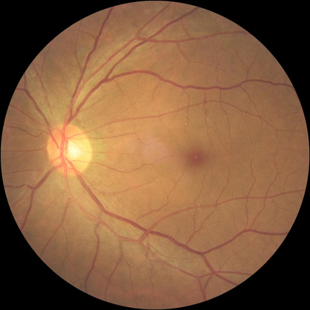
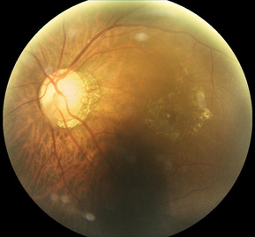
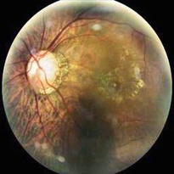
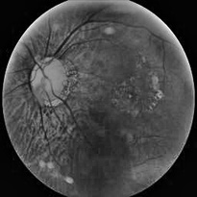
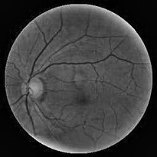

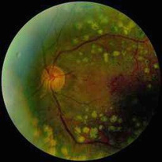

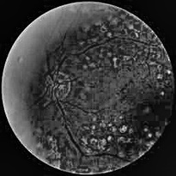
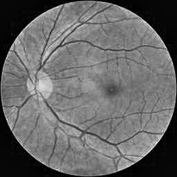
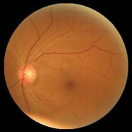

Training
Images
Cropped
Images
RGB CLAHE + MIRNET
Resized to
256x256
RGB CLAHE
RGB CLAHE + MSR
IMAGE PREPARATION

Slide 15
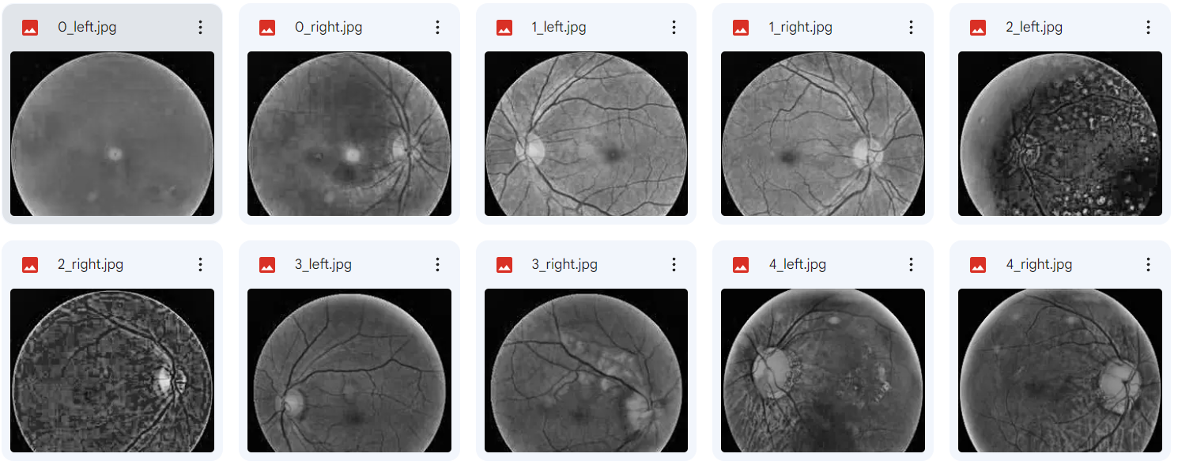
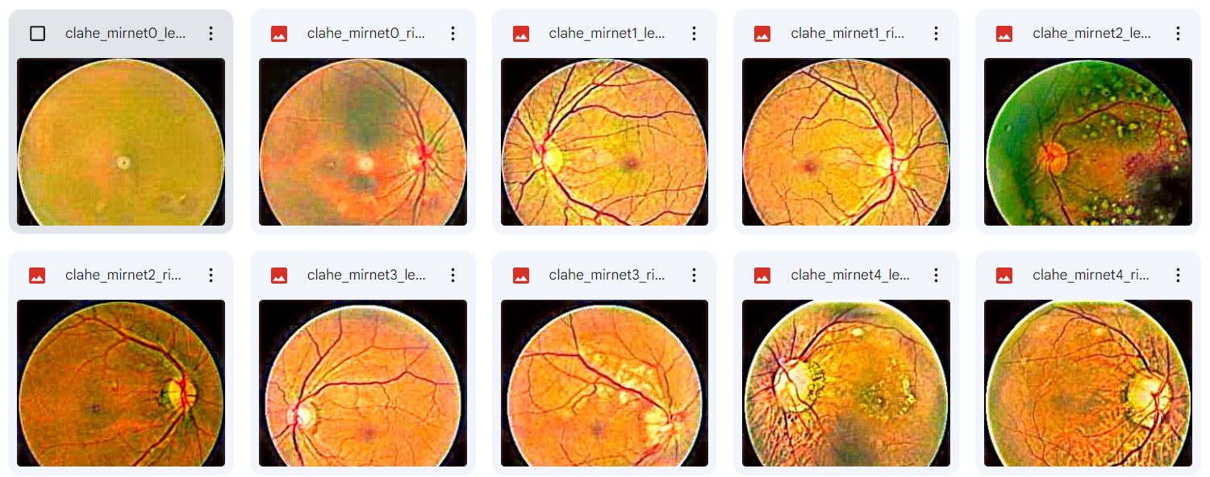
RGB CLAHE + MSR
RGB CLAHE + MIRNET

Slide 16
Class Imbalance
Back to Index
SMOTE and TomekLinks
SMOTE and Tomek Links is sequentially applied to the dataset SMOTE oversamples majority classes TomekLinks undersamples minority classes

Slide 17
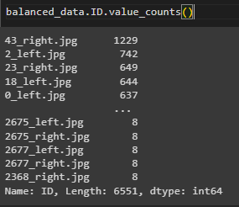
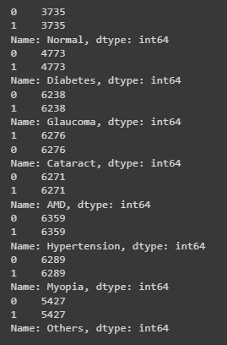
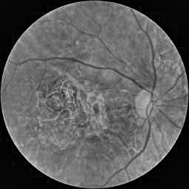
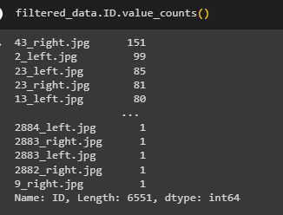
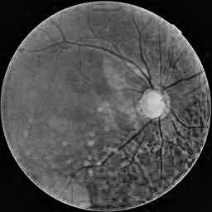
Class Imbalance
43_right.jpg : AMD + Glaucoma
2883_right.jpg : Normal

Slide 18
Back to Index
Transfer Learning
Pre-trained model is trained on a large dataset for a specific task.
A starting point for learning.
Avoids training a model from scratch for the new task.
Leverages the existing knowledge to accelerate learning and improve performance.
Enables faster convergence and better generalization on the new task.

Slide 19


KERAS TUNER FOR HYPERPARAMETERS
VGG16
VGG16
Preprocessed Images
(CLAHE+MSR & CLAHE+MIRNET)
ImageNet Dataset
RESNET50
RESNET50
Pretrained Models
Trained Models
Customized top layers
with trainable parameters

Slide 20

Back to Index
Pre-Trained Models
RESNET50 and VGG16
Excellent performance in the ImageNet Challenge
Tackles computational complexity

Slide 21

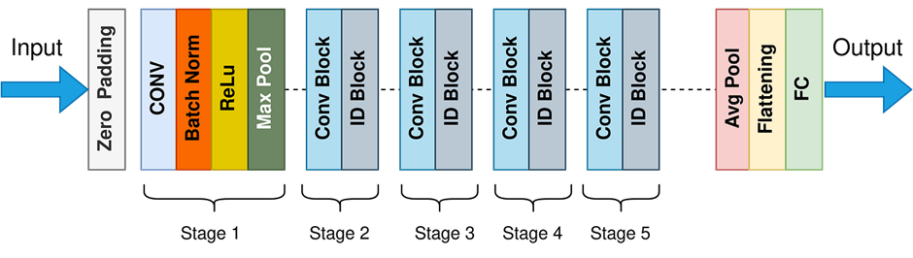
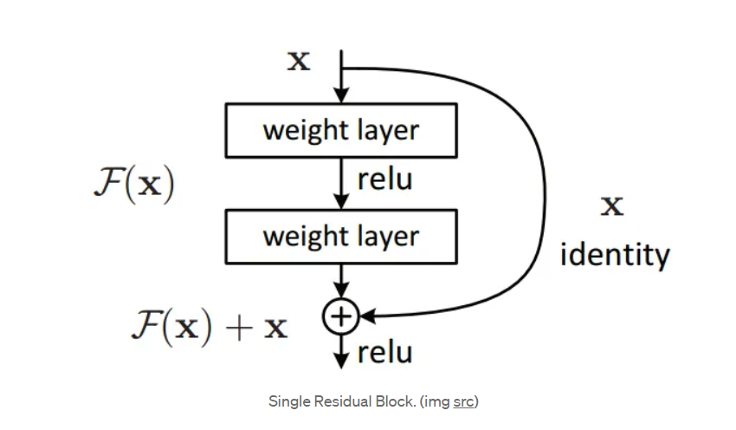
RESNET50 Architecture
Notes:
An identity block is a building block within the ResNet-50 model that preserves the input information without any changes. It consists of a series of convolutional layers, batch normalization, and activation functions. The purpose of the identity block is to help the network learn more complex features by providing a direct connection (shortcut or skip connection) from the input to the output of the block. This shortcut connection helps with gradient flow during training and can aid in preventing vanishing gradients.
The ResNet-50 model is composed of multiple such identity blocks stacked together, allowing the network to learn increasingly sophisticated features and make accurate predictions on complex visual tasks.
The main reasons for using zero padding are:
Preservation of spatial resolution: Convolution operations without padding can lead to a reduction in spatial dimensions (width and height) of the output feature maps compared to the input. By adding zeros around the input, the spatial dimensions of the output feature maps can be kept the same as the input, preserving the spatial resolution.
Mitigation of boundary effects: Without padding, the information at the boundaries of the input may be underrepresented in the output feature maps. Adding zeros around the input helps to ensure that the convolutional filters have sufficient receptive field coverage across the entire input, reducing the boundary effects.
Alignment of output and input spatial dimensions: Zero padding allows for easier alignment between different layers in a network. When the input size is padded to match the output size, it simplifies the architecture design and makes it easier to stack multiple layers or perform skip connections, such as in the case of ResNet-50.

Slide 22
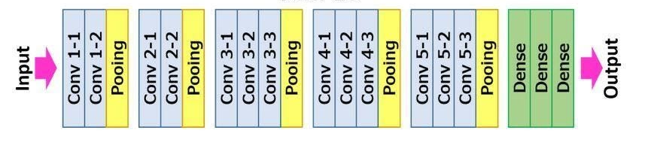
Back to Index
VGG16 Architecture
Learn increasingly abstract features
Use a backpropagation algorithm
Gradients used to update the weights, iteratively fine-tuning
Notes:
Visual Geometry Group (VGG) at the University of Oxford proposed VGG16, a convolutional neural network architecture. It has gained popularity for its deep architecture and remarkable performance in various computer vision tasks. The name "VGG16" refers to the number of layers in the network, specifically 16 layers.
The core of the VGG16 architecture is a stack of 13 convolutional layers, followed by 3 fully connected layers. The convolutional layers are responsible for learning and extracting features from input images. VGG16 adopts a uniform configuration of using 3x3 filters throughout these convolutional layers. This choice of filter size enables the network to capture finer details and enhances its ability to learn complex hierarchical representations of visual features.
Using multiple convolutional layers stacked on each other allows VGG16 to learn increasingly abstract features as the network goes deeper. The network gradually progresses from low-level features such as edges and textures to higher-level features representing more complex patterns and objects. This depth and layer-wise organization contribute to the network's ability to effectively model and understand visual data.
Following the stack of convolutional layers, VGG16 includes three fully connected layers responsible for the final classification or prediction task. These fully connected
layers combine the high-level features learned by the preceding convolutional layers to make predictions.
During training, VGG16 learns the weights of its layers using a large labeled dataset, such as the ImageNet dataset. During the training process of VGG16, the model utilizes the backpropagation algorithm. This algorithm computes the gradients of the loss function concerning the model's weights. These gradients are then used to update the weights, iteratively fine-tuning the network's parameters and optimizing its overall performance. By iteratively adjusting the weights based on the computed gradients, VGG16 can learn to make more accurate predictions and improve its ability to classify and understand visual data.

Slide 23
Keras Tuning
Back to Index
Model: "sequential_1"________________________
Layer (type) Output Shape Param # =============================================
resnet50 (Functional) (None, 7, 7, 2048) 23587712
flatten_1 (Flatten) (None, 100352) 0
dense_5 (Dense) (None, 512) 51380736
dense_6 (Dense) (None, 512) 262656
dense_7 (Dense) (None, 512) 262656
dense_8 (Dense) (None, 8) 4104 ===================================================
Total params: 75,497,864
Trainable params: 51,910,152
Non-trainable params: 23,587,712 __________________________________________
The hyperparameter search is complete. The optimal number of layers is 3 and the number of neurons is 512.
Model: "sequential_3" ________________________
Layer (type) Output Shape Param #
==============================================
vgg16 (Functional) (None, 7, 7, 512) 14714688
sequential_2 (Sequential) (None, 8) 9932936
=================================================
Total params: 24,647,624
Trainable params: 9,932,936
Non-trainable params: 14,714,688 ________________________________________
The hyperparameter search is complete. The optimal number of layers is 3 and number of neurons is 384.

Slide 24
Back to Index
Evaluation Metrics
ROC(Receiver Operating Characteristic) Curve represents true positive rate vs. false positive rate.
AUC (Area Under ROC Curve) of 1 indicates a perfect classifier, 0.5 suggests randomness.
Loss measures error between predicted and actual labels.
High AUC indicates accurate classification.
Low loss signifies better alignment with true labels.
Analyzing AUC and loss is valuable for multi-label binary classification.

Slide 25
Back to Index
Results

Slide 26
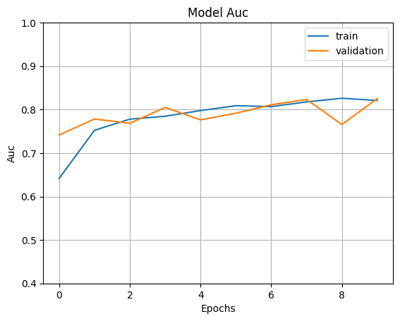
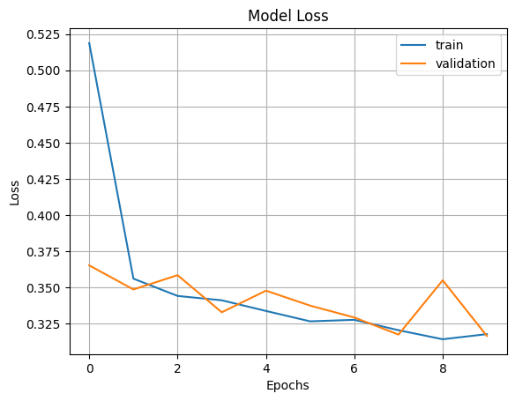
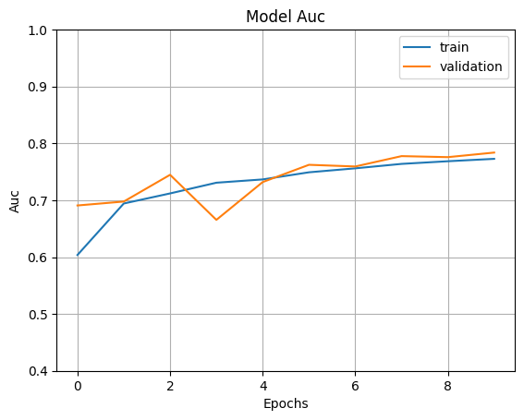
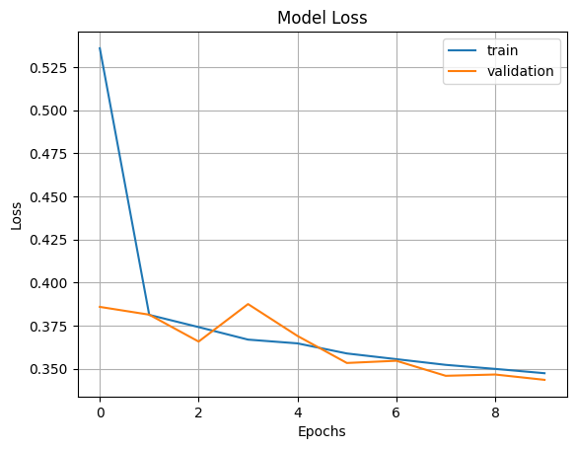
Model | Preprocessing On Images | AUC | LOSS
RESNET50 | CLAHE+MIRNET
 | CLAHE+MSR
Back to Index

Slide 27
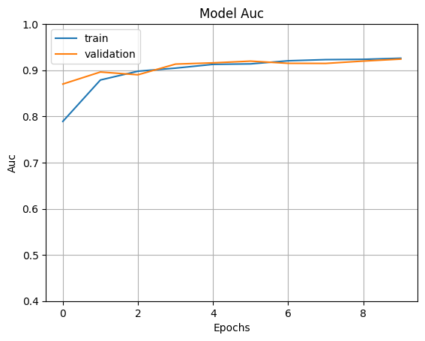
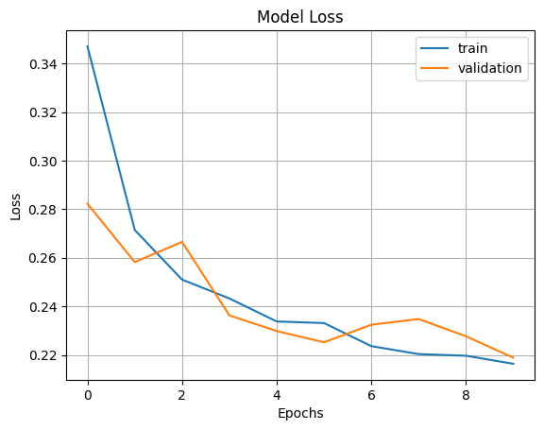
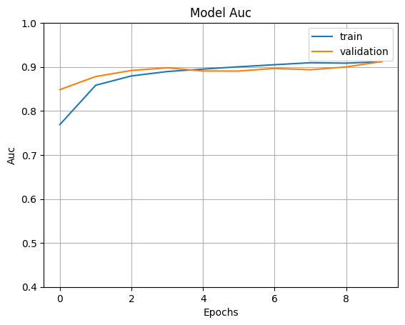
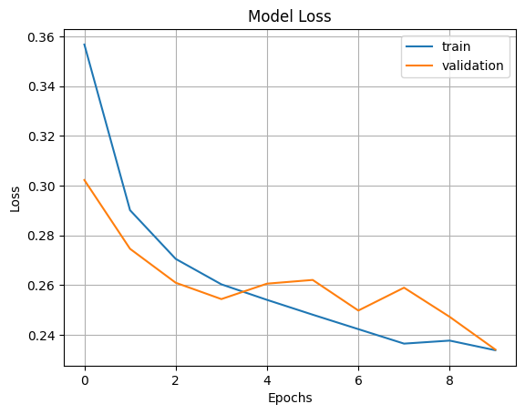
Model | Preprocessing On Images | AUC | LOSS
VGG16 | CLAHE+MIRNET
 | CLAHE+MSR
Back to Index

Slide 28
Results
Back to Index
Model Performance
Generalization
Great distinguishing capabilities
Captures relevant features
Despite the number of training parameters, VGG16 slightly outperforms RESNET50 model
Convergence of loss function
Will be good at generalizing of unseen data
No overfitting
Model Stability
Convergence of both AUC and Loss functions
Lack of significant fluctuations

Slide 29





Analysis and Conclusion
Back to Index
RESNET50 vs VGG16
Real Life Clinical data personalized treatment
Explore feature importance analysis, attention mechanisms, etc
Notes:
While the ResNet50 model performs slightly lower in terms of AUC, it still demonstrates considerable discriminative ability. This highlights the effectiveness of the residual connections and skip connections employed in the ResNet architecture, which help mitigate the vanishing gradient problem and improve feature learning.
Overall, the trained machine learning models show promising performance, generalization ability, and stability in classifying fundus images into their respective categories.

Slide 30
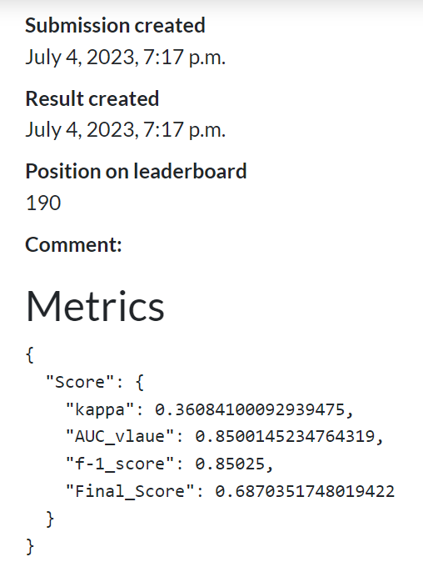
Back to Index
Supplementary Results
Generic Preprocessing techniques
Mapping left eye, right eye labels to a singular patient
Minimal computational complexity on both Transfer Learning and Image Preprocessing
Rapid and Inclusive Categorization at an early stage

Slide 31
References
Back to Index
Mayya, V., Kamath S, S., Kulkarni, U., Kaiyoor Surya, D., & Acharya, U. R. (2021). An empirical study of preprocessing techniques with convolutional neural networks for accurate detection of chronic ocular diseases using fundus images. Computer Methods and Programs in Biomedicine, 206, 106267. https://doi.org/10.1016/j.cmpb.2021.106267.
Islam MT, Imran SA, Arefeen A, Hasan M, Shahnaz C (2019) Source and camera independent ophthalmic disease recognition from fundus image using neural network. In: 2019 IEEE International conference on signal processing, information, communication systems (SPICSCON).
Li N, Li T, Hu C, Wang K, Kang H (2021) A benchmark of ocular disease intelligent recognition: One shot for multi-disease detection. In: Wolf F, Gao W (eds) Benchmarking, measuring, and optimizing. Springer International Publishing, Cham, pp 177–193
He J, Li C, Ye J, Qiao Y, Gu L (2021) Multi-label ocular disease classification with a dense correlation deep neural network. Biomedical Signal Processing and Control, pp 63.
Muramatsu C, Nakagawa T, Sawada A, Hatanaka Y, Hara T, Yamamoto T, Fujita H (2011) Automated segmentation of optic disc region on retinal fundus photographs: Comparison of contour modeling and pixel classification methods. Comput Methods Prog Biomed 101(1):23–32 39.
Fu H, Cheng J, Xu Y, Zhang C, Wong D, Liu J, Cao X (2018) Disc-aware ensemble network for glaucoma screening from fundus image. IEEE Trans Med Imaging 37(11):2493–2501 40. Diaz-Pinto A, Morales S, Naranjo V, Kohler T, Mossi J, Navea ¨ A (2019) Cnns for automatic glaucoma assessment using fundus images: an extensive validation. BioMedical Engineering Online, 18(1) 41.
Zhao R, Chen X, Liu X, Chen Z, Guo F, Li S (2020) Direct cup-todisc ratio estimation for glaucoma screening via semi-supervised learning. IEEE J Biomed Health Inf 24(4):1104–1113 42. Sreng S, Maneerat N, Hamamoto K, Win K (2020) Deep learning for optic disc segmentation and glaucoma diagnosis on retinal images. Applied Sciences (Switzerland), 10(14)
Juneja M, Singh S, Agarwal N, Bali S, Gupta S, Thakur N, Jindal P (2020) Automated detection of glaucoma using deep learning convolution network (g-net). Multimed Tools Appl 79(21-22):15531–15553 44. Civit-Masot J, Dominguez-Morales M, Vicente-Diaz S, Civit A (2020) Dual machine-learning system to aid glaucoma diagnosis using disc and cup feature extraction. IEEE Access 8:519–529

Slide 32

Thank you!
Do you have any questions?

